Slide 1
NAME:- SWAPNIL RATNAPARKHI
PROJECT NAME:-Basic Calculator Using Tkinter
ORGANISATION NAME:-Nexthikes IT Solution Ltd

Slide 2
Project Overview:-
This project is a Basic Calculator application developed using Python's Tkinter library. The calculator provides a graphical user interface (GUI) that allows users to perform simple arithmetic operations such as addition, subtraction, multiplication, division, and percentage calculations. The interface includes a display entry and a grid of clickable buttons for digits and operators. It handles real-time input, evaluates mathematical expressions, and includes basic error handling for invalid inputs.
A simple GUI-based calculator built using Python's Tkinter library.
Supports basic arithmetic operations: addition, subtraction, multiplication, division, percentage, and clear.
Designed with a clean layout and responsive button interactions.

Slide 3
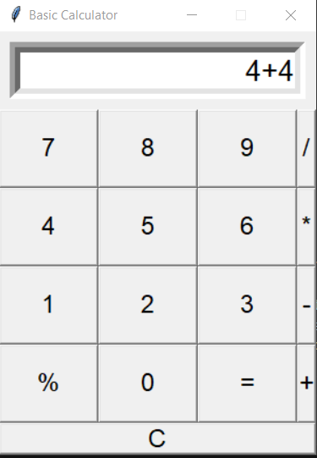
Key Features:-
User Interface:-
Numeric and operator buttons
Entry display for real-time expressions and results
Functionality:-
Expression evaluation using eval()
Handles % as percentage
Error handling for invalid inputs
“C” button to clear input

Slide 4
Challenges Overcome in the Code:-
Handling Dynamic Input from GUI Buttons:-
Challenge: Capturing which button was clicked and updating the display accordingly.
Solution: Used event.widget.cget("text") inside the click() function to get the text of the clicked button dynamically.
2. Evaluating Arithmetic Expressions Safely:-
Challenge: Calculating expressions entered as strings can cause errors or security risks.
Solution: Wrapped eval() inside a try-except block to handle errors gracefully and return "Error" without crashing.
3. Supporting Percentage Calculations:-
Challenge: Python's eval() doesn't handle % as "percentage".
Solution: Replaced % with /100 before evaluation:
How It Works
User clicks buttons → Expression is built in the entry field.
Pressing “=” evaluates the expression.
“C” clears the entry field.
Technologies Used
Language: Python
Library: Tkinter (for GUI)

Slide 5
Improvements:-
Add keyboard input support
Improve layout aesthetics (colors, themes)
EnFuturehance error messages (e.g., division by zero)
Use a safer expression parser instead of eval()

Slide 6
THANK YOU

